Slide 1
CS Change Impact Analysis
VC05 – Course Management
August 9, 2019

Slide 2
Objective(s) and Outcome(s)
Session Objective(s)
Overview of Course Catalog
Course Catalog conversion strategy
Begin journey to find the best practice
Session Outcome(s)
Begin reviewing and/or contemplating Course Catalog-related changes
Understand the role of the Course Catalog in your college’s curriculum management business processes

Slide 3
Academic Structure
Coding foundation of PeopleSoft
Two branches of the Academic Structure:
Student – tracks a student’s Program/Plan
Course/Class – denotes which department/division owns a course or class
Today will focus on the course/class branch

Slide 4
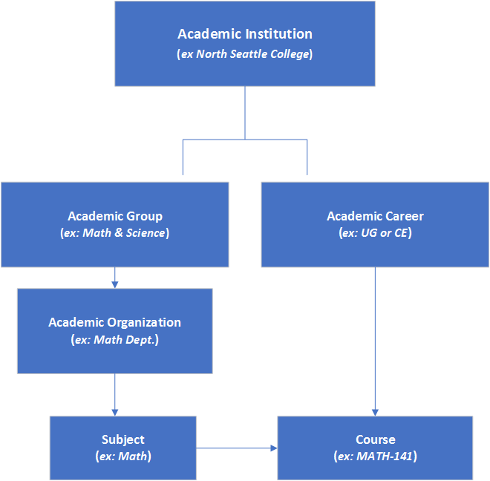
Academic Structure - Continued

Slide 5
Course and class overview
In PeopleSoft, a course must be built in the Course Catalog before any of the following activities may occur:
A course must exist to schedule a class.
A class will inherit most of its characteristics (e.g., Class Title, number of credits, Subject and Catalog Nbr, etc.)
The class must be scheduled for an enrollment to show up on a student’s transcript.
A course must exist to grant transfer credit.

Slide 6
Course Catalog
Used to define course information including:
Description
Units
Long Title
Contact Hours
When creating a course, you must set up course equivalencies and local course attributes.
The data you enter in the course catalog sets the defaults values for scheduled classes

Slide 7
Course catalog - demo
Creating a new Course (single component)
Academic Institution ID: WA140 Course ID: 090004
Catalog Data
Course Offerings
Course Components
GL Interface

Slide 8
Multi-Component Course
Multiple component courses contain a combination of instructional elements
Example – ANTH& 999 has two components; a lecture and a lab
One component is considered the primary section
One grade is given in this course and is associated to the primary component
Each component has its own weekly contact hours and units
Components can be required or optional

Slide 9
Multi-component Course – demo
Creating a new Course (WA171 - 090003)
Course Component
Attributes
Course Attendance
Room Characteristics

Slide 10
Requisites
Course requisite design lets you structure requirements that can be shared among many courses
As a district, must define how requisites will be structured moving forward.

Slide 11
Requisites - DEMO
Add a prerequisite

Slide 12
FEES – DEMO
Adding a course fee
Add multiple course fees

Slide 13
Best practices for maintaining a course
Recommend making all course changes prior to class building and enrollment
Always insert a new effective dated row each time a change is made
Use an effective date after the last day of the current term and at least one day prior to the term you want this change to take effect
Never use correct history to makes changes
Establish local timelines for when changes can be made

Slide 14
Best Practices – CONTINUED
Changes do not automatically roll down to the classes scheduled or to students already enrolled
Use Course Roll page to update changes to:
Career
Academic Group
Subject Area
Catalog Number
Description (course title)
Any other changes must be done manually to each class scheduled and students enrolled

Slide 15
BEST PRACTICES – DEMO
Update a course title
Course Roll

Slide 16
BEST PRACTICES – CONTINUED
Reference the SBCTC Student & Course Coding Manual for up-to-date required coding, including:
Course Attributes – Fund Source, Course Intent, Low Cost Course Material, etc.
CIP Codes
Common Course Numbering
Special Populations

Slide 17
Inactivating a Course
Two steps to inactivating a course:
Add a new effective dated row and remove flag that allows the course to be scheduled.
This keeps the course active but prevents any future scheduling
After last term course will be offered, add a new effective dated row and change status to inactive.
Do not inactivate older rows for historical purposes → ensures Enrollment Requirements and Academic Advisement Reports function correctly
Effective date must be after the last day of the last term offered → prevents issues with FTE calculations
After effective date the course will no longer display in the self-service catalog search

Slide 18
Inactivating a Course – DEMO
Inactivate a course

Slide 19
Questions?

